Slide 1
Watson STT Websocket Node-Red Flow Setup Guide
Kohzo Momose(kmomose@jp.ibm.com)
Cloud&Cognitive Technical Sales, IBM Japan

Slide 2
Installation Step
Import nodered-websocket.json into your Node-Red
Order Watson STT
Check the STT Service Credential
Set your Service Credential
Chose STT model
Set STT model
(Optional) Setup Custom STT
Demonstration

Slide 3
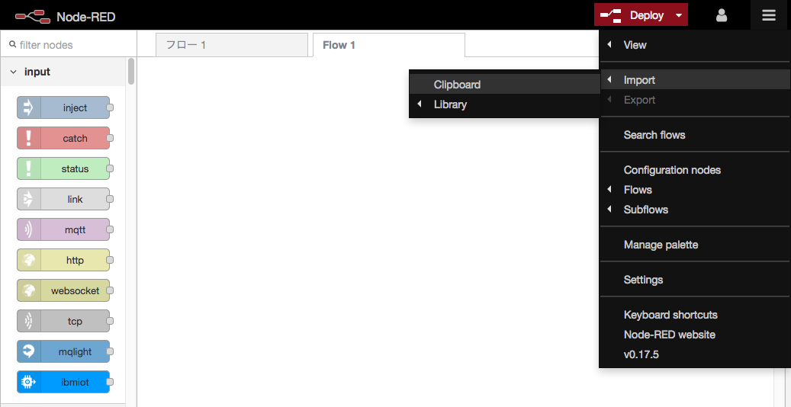
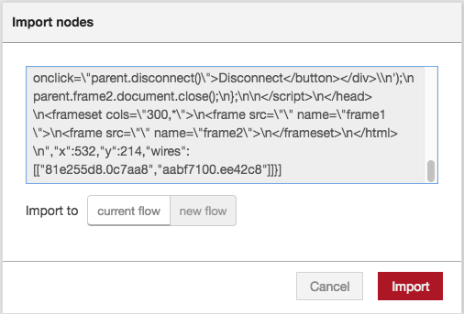
1. Import nodered-websocket.json
Copy&Paste the NodeFlow from Node-Red Library or GIT「Watson Speech to Text websocket API 」

Slide 4
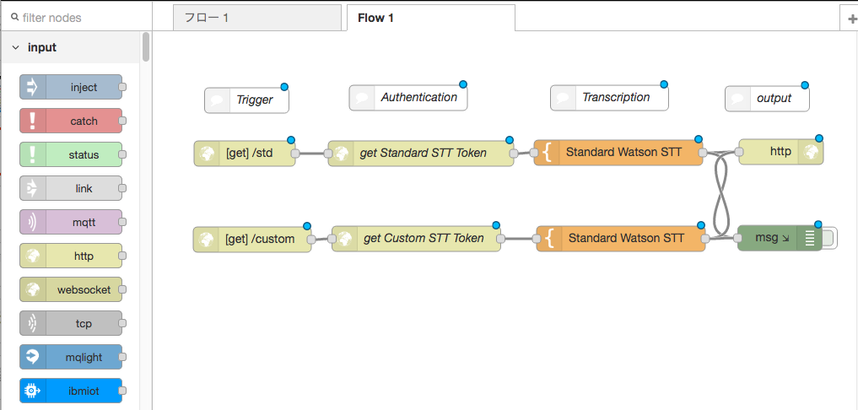

Slide 5
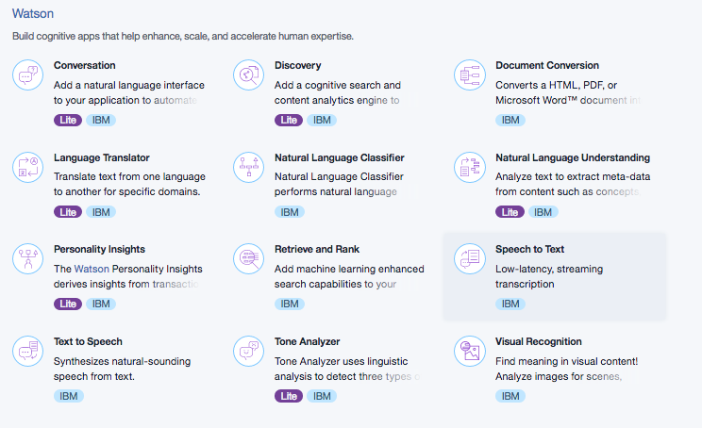
２. Order Watson STT
(Ref) https://www.ibm.com/watson/developercloud/doc/common/index.html

Slide 6
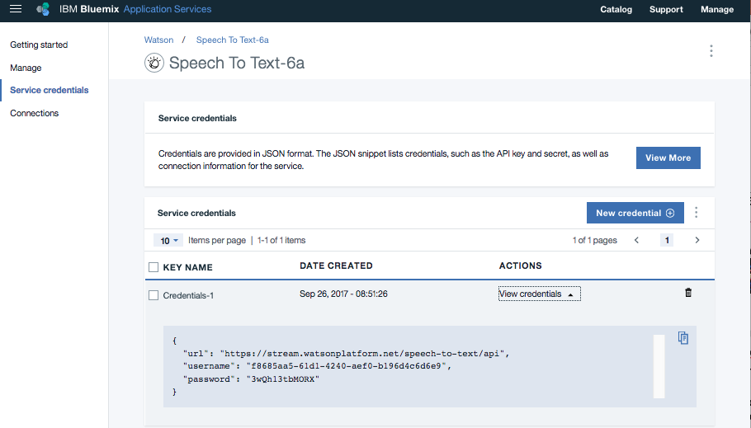
３. Check your STT service credential

Slide 7
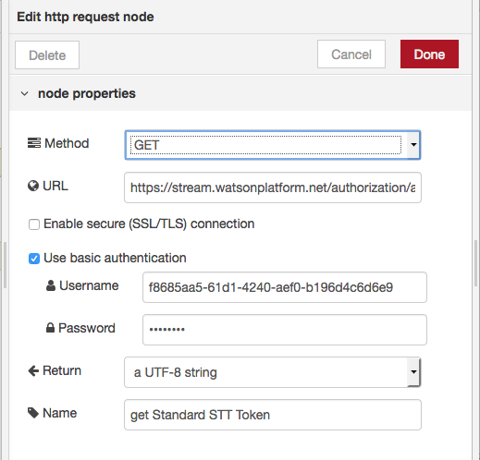
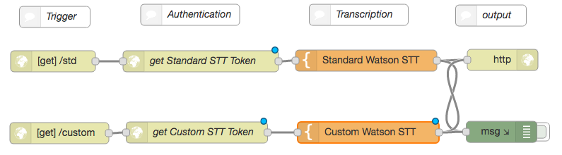
４. Set your STT service credential

Slide 8
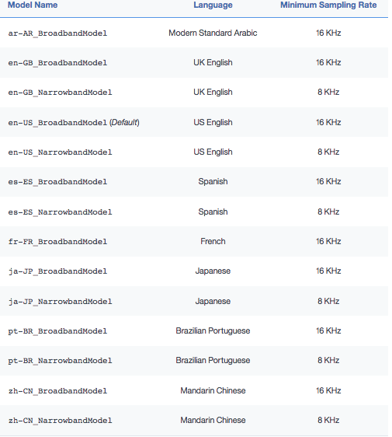
５. Chose STT Model
Chose STT Model corresponding your preferred language in the list
Set the model name in the STT Node (see next page for the detail)
https://console.bluemix.net/docs/services/speech-to-text/input.html#input

Slide 9
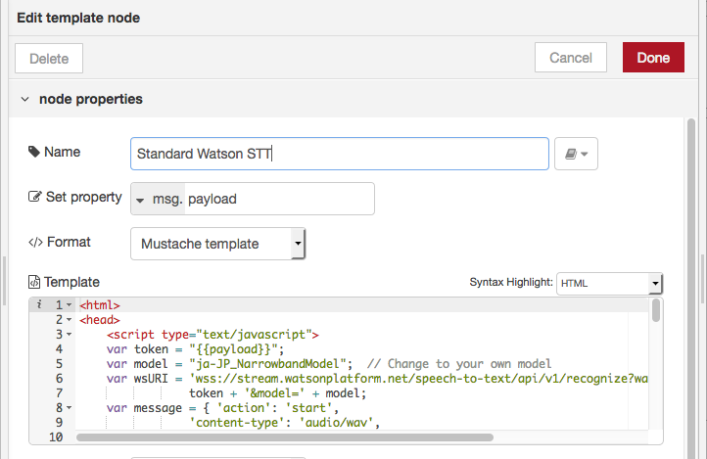
６. Set STT model name

Slide 10
７. (Optional) Setup Custom STT

Slide 11
７. (Optional) Setup Custom STT
Execute the following command at your laptop command line to get the customization_id of your custom STT
-u {your standard STT user}:{your standard STT password}
base_model_name: {your chosen language model}
Set the customization_id to the STT Node (see next page for the detail)
macbook-air:~ momosekohzo$ curl -X POST -u f8685aa5-61d1-4240-aef0-b196d4c6d6e93wQh13tbMORX --header "Content-Type: application/json" --data "{\"name\": \"Example model\", \"base_model_name\": \"ja-JP_NarrowbandModel\", \"description\": \"Customization for STT\"}" "https://stream.watsonplatform.net/speech-to-text/api/v1/customizations"
{"customization_id": "a636b640-a2a0-11e7-806a-99e03c64b58a"}
macbook-air:~ momosekohzo$
(Ref) https://console.bluemix.net/docs/services/speech-to-text/custom.html#createModel

Slide 12
７. (Optional) Setup Custom STT
Execute the following command at your laptop command line to get the customization_id of your custom STT
-u {your standard STT user}:{your standard STT password}
base_model_name: {your chosen language model}
Set the customization_id to the STT Node (see next page for the detail)
macbook-air:~ momosekohzo$ curl -X POST -u 72ebf8ff-f558-42e9-9e8e-3a26a8fd3feb:TDBoq03Dc6X0 --header "Content-Type: application/json" --data "{\"name\": \"Example model\", \"base_model_name\": \"ja-JP_NarrowbandModel\", \"description\": \"Customization for STT\"}" "https://stream.watsonplatform.net/speech-to-text/api/v1/customizations"
{"customization_id": "a636b640-a2a0-11e7-806a-99e03c64b58a"}
macbook-air:~ momosekohzo$
(Ref) https://console.bluemix.net/docs/services/speech-to-text/custom.html#createModel

Slide 13
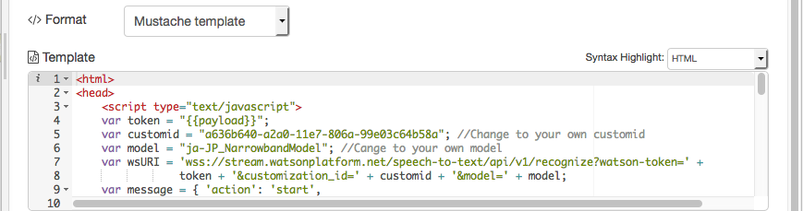
７. (Optional) Setup Custom STT

Slide 14
８. Demonstration
After deploying the flow
Prepare your voice recording file in supported format (flac/mp3/mpeg/116/wav/ogg/webm/mulaw/basic)
Browse
https://{yournodered}/stt to access Standard STT
https://{yournodered}/custom to access Custome STT
*Note: To execute Custom STT you may need to add a corpus before invoking Custome STT ( pls see https://console.bluemix.net/docs/services/speech-to-text/custom.html#addCorpora )

Slide 15
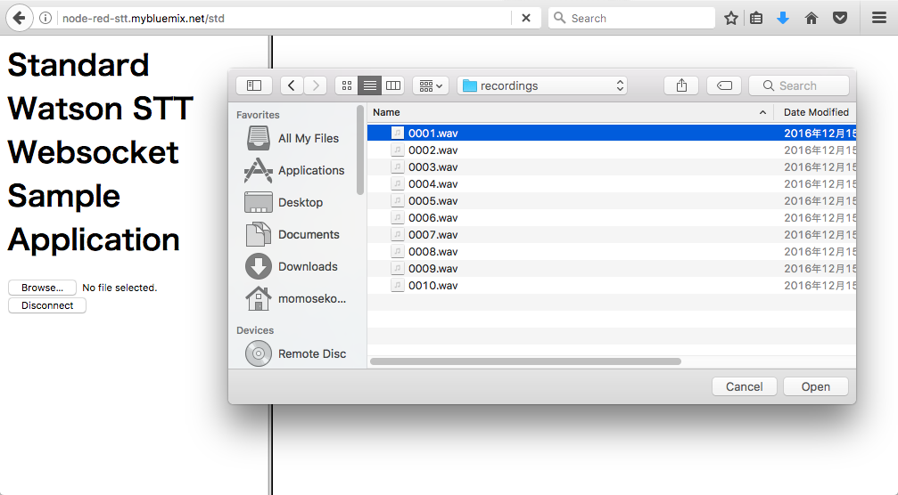
Select your voice record file

Slide 16
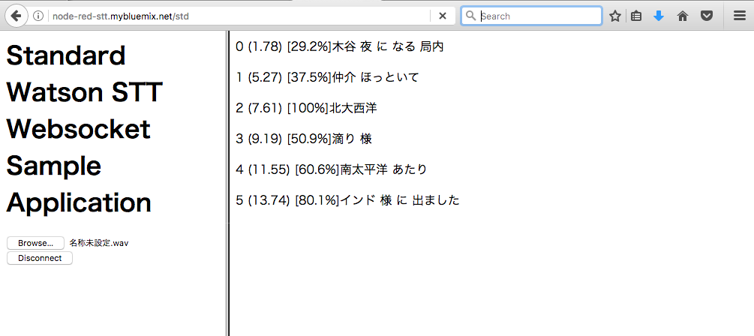
8. Demonstration - Result
Timestamp
Confidence
Transraled Text

